Slide 1

DESIGN & DEVELOPMENT OF TRIP PLANNER SYSTEM
Major Project - II
CS- 805
Problem Statement:. Trip planning is often a complex and time-consuming process, requiring users to consider multiple factors such as destinations, routes, accommodations, and budgets. The 'Trip Planner System' aims to address these challenges by designing and developing an intelligent, user-friendly platform that optimizes travel planning through smart automation and interactive maps.
Project Group Number: 13
Group Member Details:
1. Irtiqa Aafreen - 0187CS211075
2. M.Maaz Nafees - 0187CS211092
3. Mujtaba Farooqui - 0187CS211103
4. Mehkasha Mansoori - 0187CS211101
Guide Details: Prof.Nargish Gupta

Slide 2
Idea/Approach Details
Describe your idea Solution/Prototype here:
Trip planning is often a complex and time-consuming process, requiring users to consider multiple factors such as destinations, routes, accommodations, and budgets. Traditional methods of planning can be overwhelming, leading to inefficiencies and missed opportunities for a seamless travel experience.
Abstract:
The Trip Planner System (TPS) is an intelligent and user-friendly platform designed to streamline and enhance the travel planning experience. By automating itinerary creation, route optimization, and real-time notifications, the system simplifies the complexities of trip planning. It offers online access to travel catalogs and interactive maps, allowing users to visualize and adjust their journeys with ease. Key features include smart recommendations, budget management, collaborative planning, and real-time updates, ensuring a seamless and enjoyable travel experience. With its efficient and scalable design, the Trip Planner System supports the smooth operation of travel arrangements for individuals and groups, transforming trip planning into an intuitive and stress-free process.

Slide 3



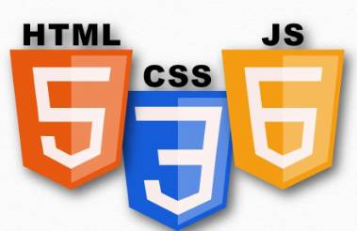
Technology stack
Describe your Technology stack here:
HTML
CSS
REACT NATIVE
FIREBASE
MYSQL

Slide 4
Project Requirements
Functional Requirements
Non Functional Requirements
User Management
Trip Creation & Management
Location Search & Recommendations
Budget Management
Transportation & Accommodation
Notifications & Alerts
Collaboration & Sharing
Maps & Navigation
Review & Feedback
Reports & History
Performance Requirements
Security Requirements
Availability Requirements
Scalability Requirements
Maintainability Requirements
Usability Requirements
Localization & Internationalization
Legal & Compliance Requirements

Slide 5
Project Requirements
Hardware and Software requirements (Developer)
Hardware and Software requirements (Client)
Hardware Requirements:
Server
Networking Equipment
Backup Solution
Software Requirements:
Operating System
Database Management System (DBMS)
Web Server
Application Framework
Programming Languages
Web Browser
Security Software
Backup and Recovery
Hardware Requirements:
Device
Storage
Network
Software Requirements:
Android/iOS
Web Server
Security Software
Backup and Recovery

Slide 6
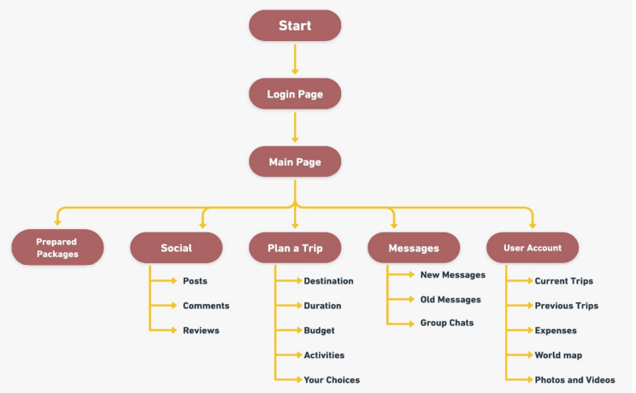
Design
Describe data flow diagram here

Slide 7
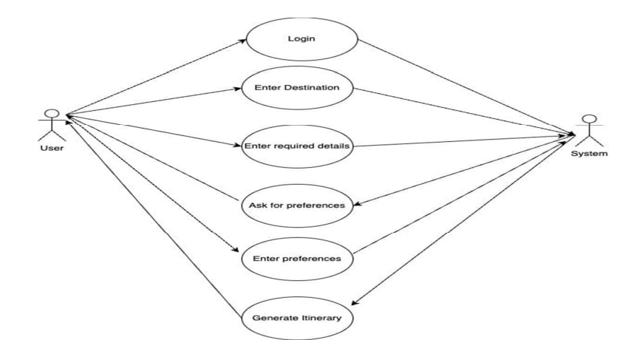
Design
Describe your Use Cases here
Describe your Dependencies / Show stopper here
Dependency on Technology
User Training
Technical Support
Limited Use Cases
Lack of Personal Interaction
Dependency on Power and Network

Slide 8
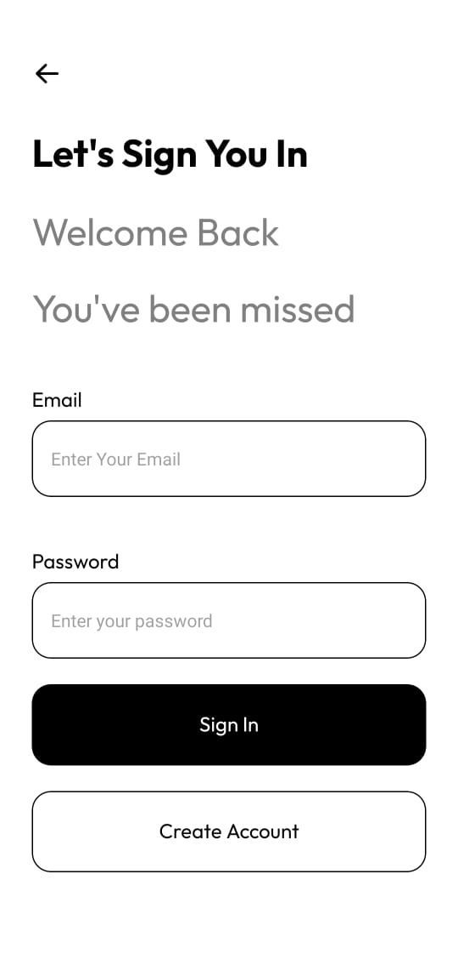
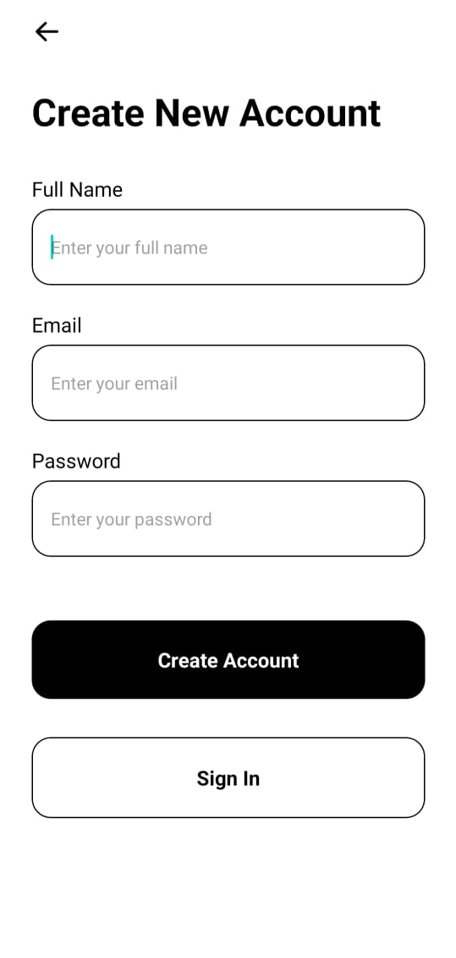
Project Screen shorts

Slide 9
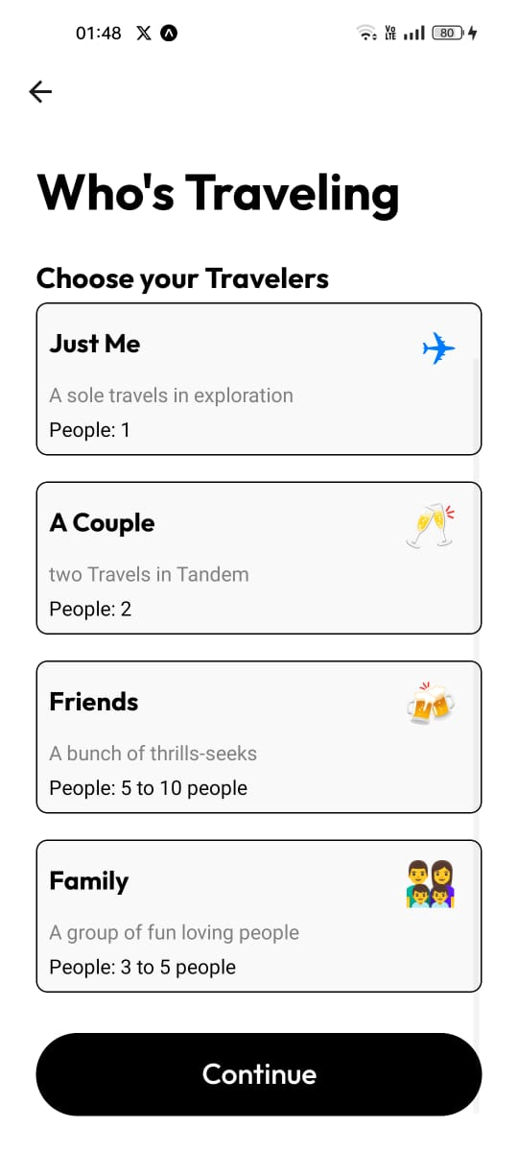
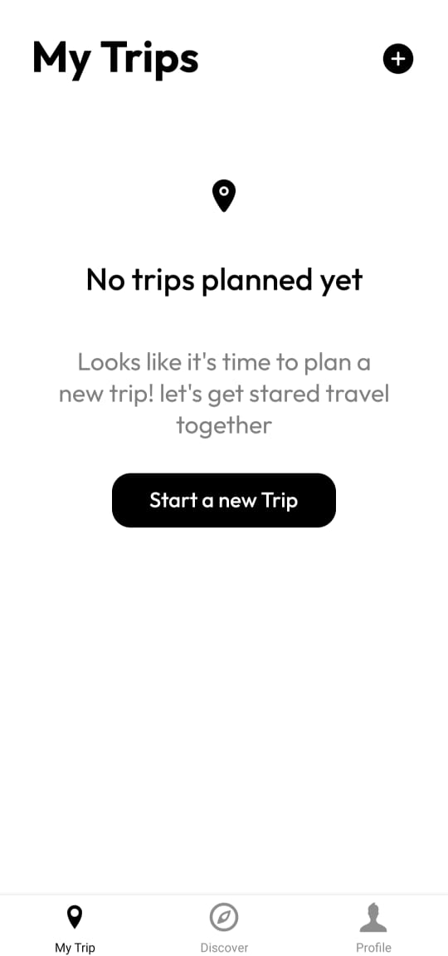
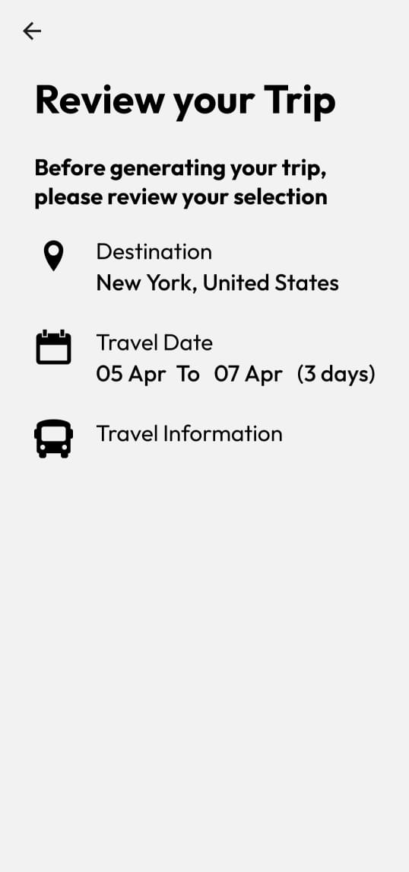

Slide 10
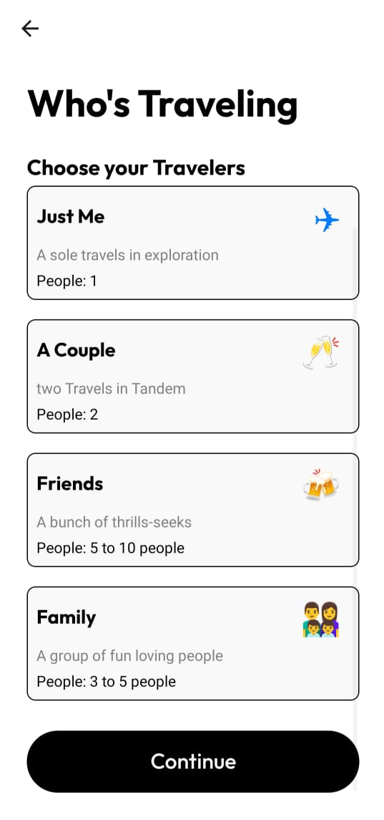
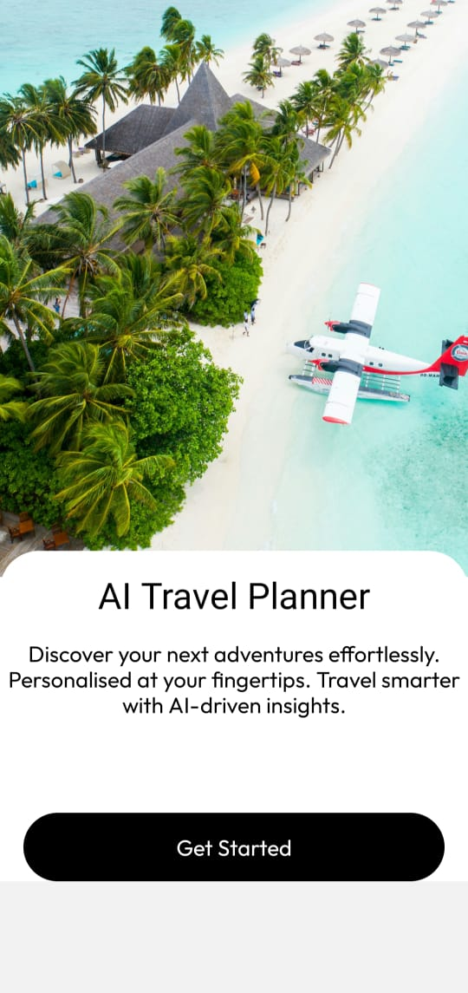

Slide 11


